Slide 1
FORECASTING EQUITY PRICE MOVEMENTS
ADAM SCHAFFROTH

Slide 2
QUESTION
“How accurately will I be able to predict the next day’s closing price based on the closing prices of past days given a certain window?”

Slide 3
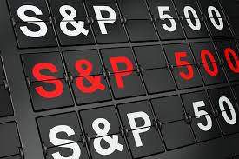
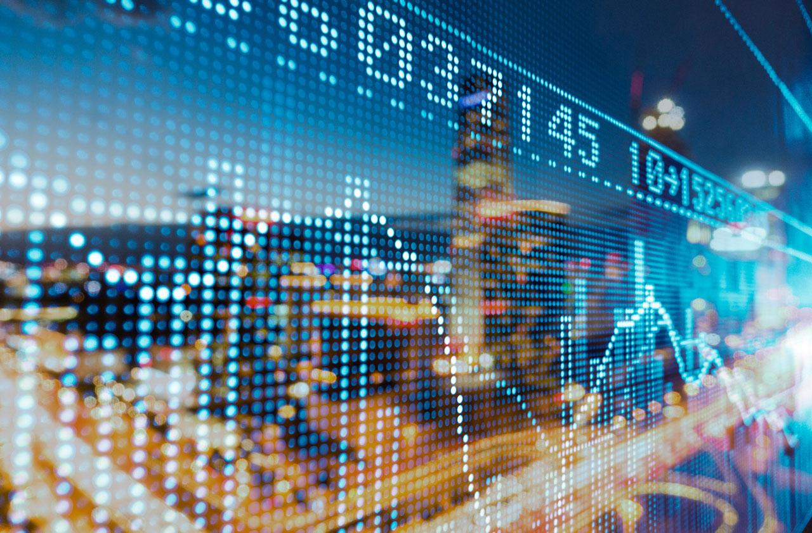
WHICH DATASET TO USE?

Slide 4
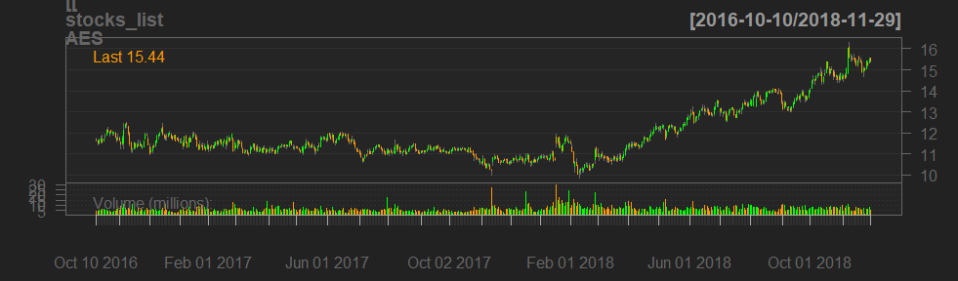
GETTING THE DATA
Bloomberg?
Quantmod!

Slide 5
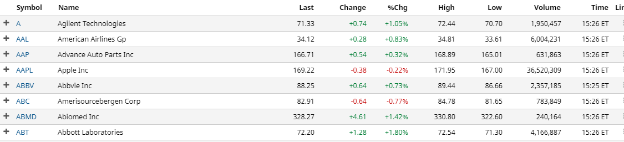
GETTING THE DATA
getSymbols( stock tickers, from = "2016-10-08", to = "2018-11-30“)

Slide 6
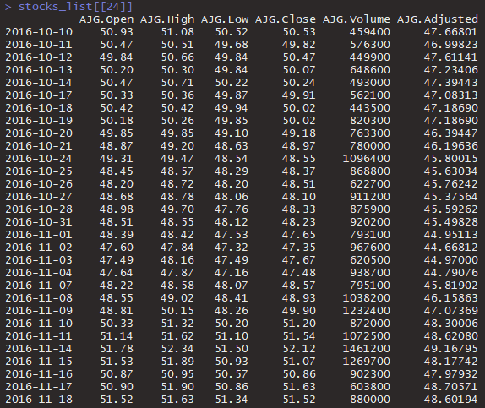
CLEANING ☹
BRK.B -> BRK-B BF.B -> BF-B
More serious offenders:
BHF, DXC, JEF, LIN, EVRG

Slide 7
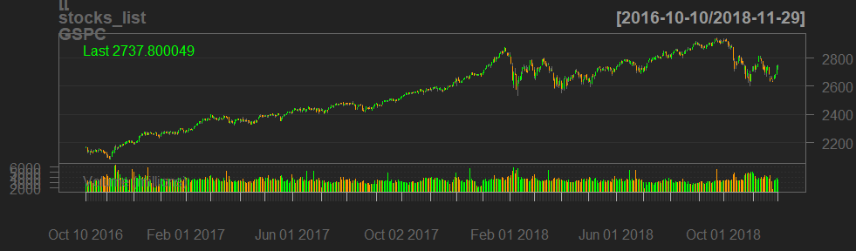
COMBINING
I put the market into my dataset!

Slide 8
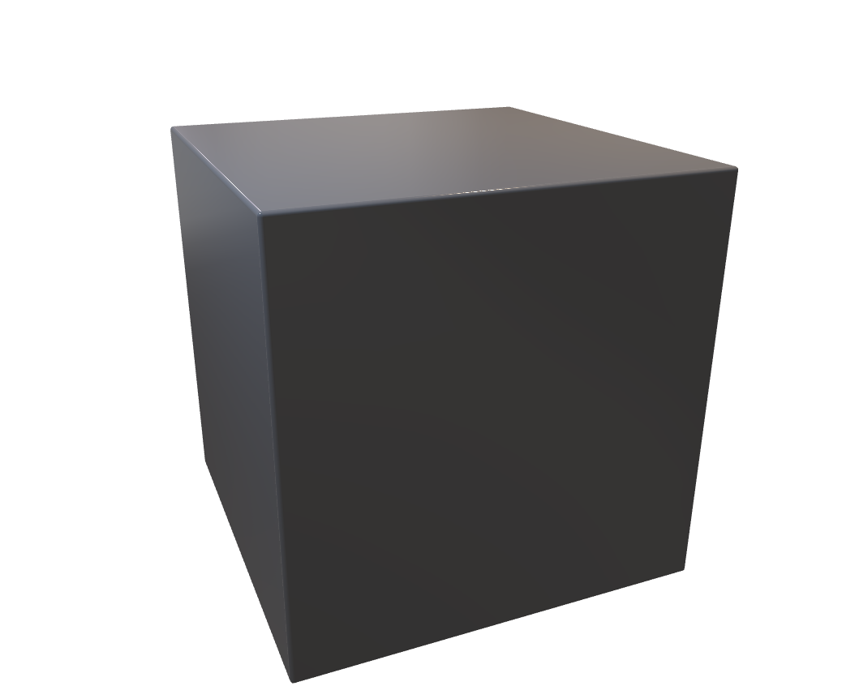
RESTRUCTURING MY DATA
Stocks (499)
Variables (6)
Closing Price
Dates (540)

Slide 9
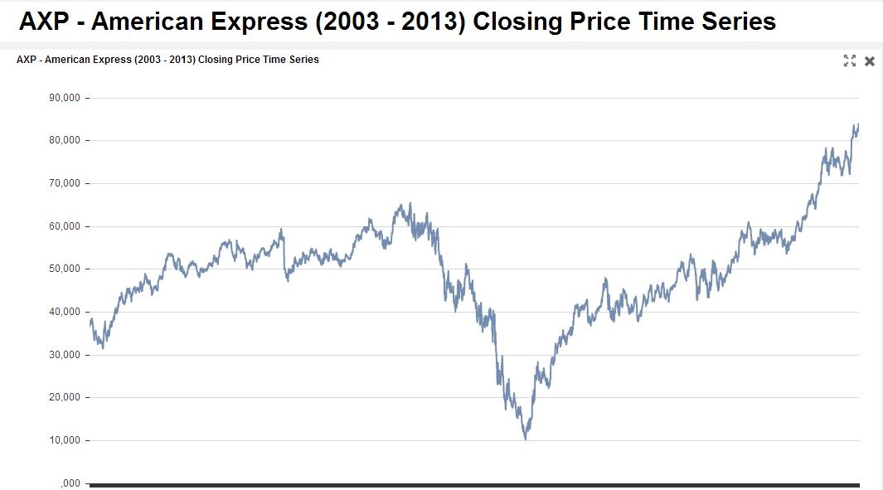
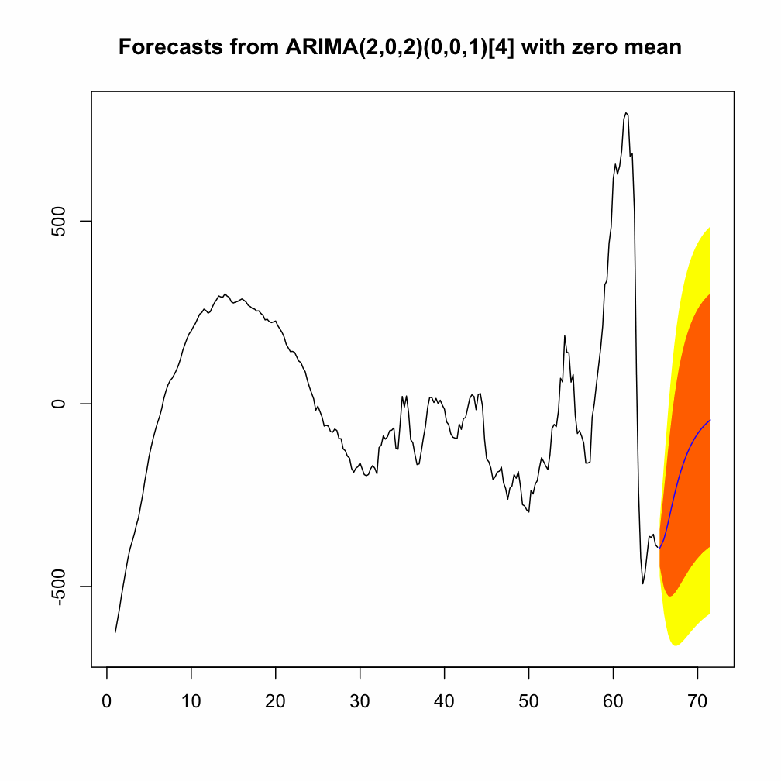
THE PLAN
windows

Slide 10
WHY ARIMA?
p: The number of lag observations included in the model, also called the lag order.
d: The number of times that the raw observations are differenced, also called the degree of differencing.
q: The size of the moving average window, also called the order of moving average.
auto.arima()

Slide 11
BUILDING MY MODEL: ARIMA LIST
ARIMA models
Stocks
window 1
Stock 1
window 2
Stock 2
window 3
Stock 3

Slide 12
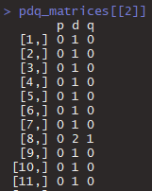
BUILDING MY MODEL: PDQ MATRICES
Stock 1
3rd window
Stock 2
Stock 3

Slide 13
BEST STOCKS
“AES" = AES Corporation, energy
"JKHY" = Jack Henry & Associates, Inc., tech, finance
"MAC" = Macerich, real estate investment trust
"NEE" = NextEra Energy
"ULTA" = Ulta Beauty

Slide 14
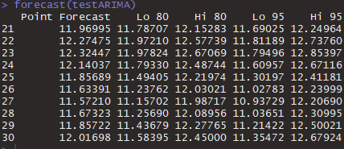
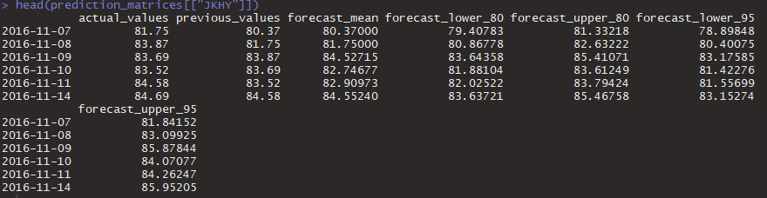
BUILDING MY MODEL: PREDICTION MATRICES
Stock 1
Stock 2
Stock 3

Slide 15

RESULTS: ACCURACY
32.19%
Is this good?

Slide 16

Accuracy Excluding ARIMA(0,1,0) models
This is the accuracy if you only trade on models with predictive power

Slide 17
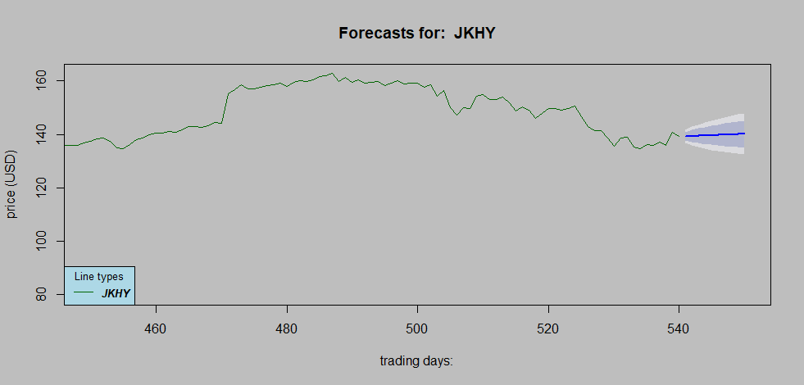
RESULTS: GRAPHS

Slide 18
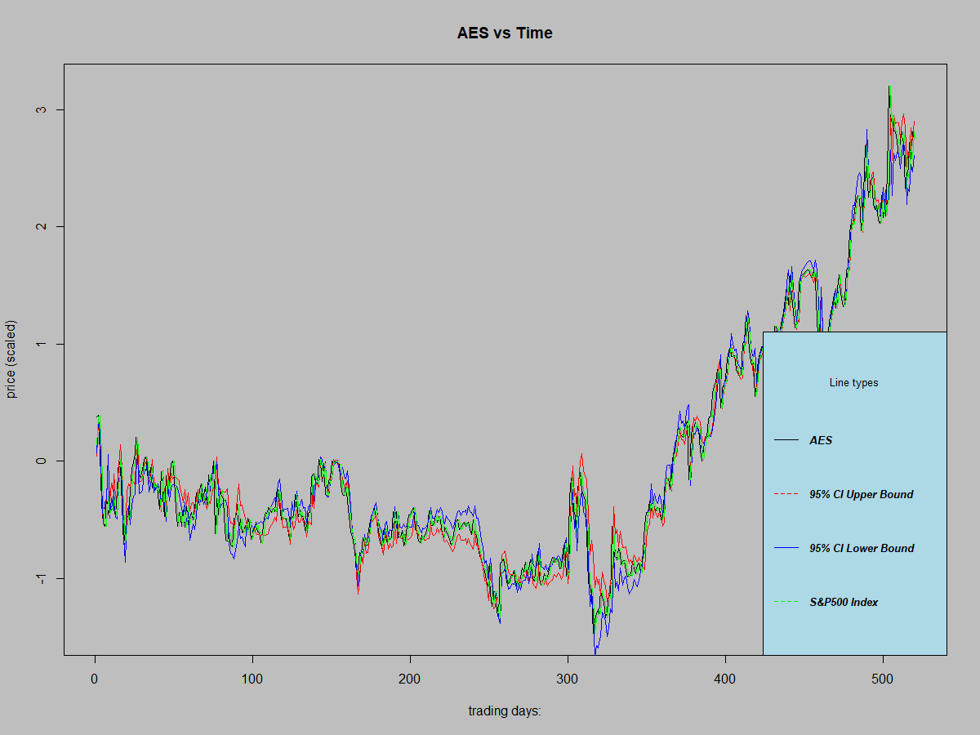

Slide 19
RESULTS: MORE GRAPHS

Slide 20
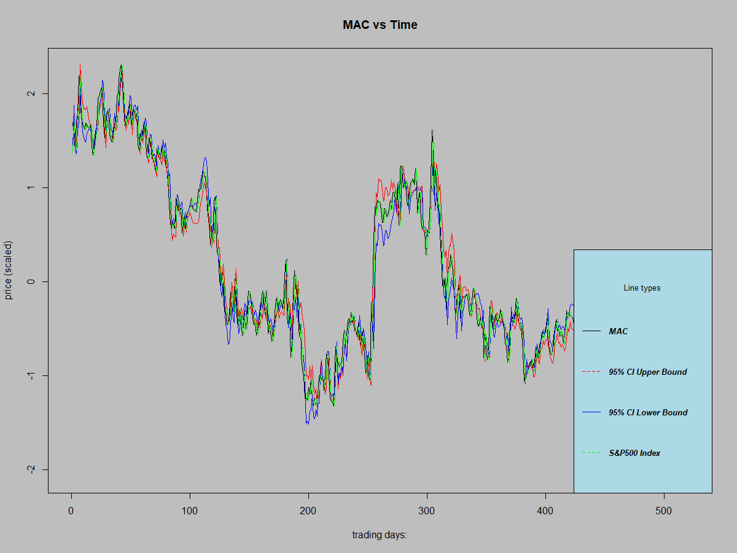

Slide 21
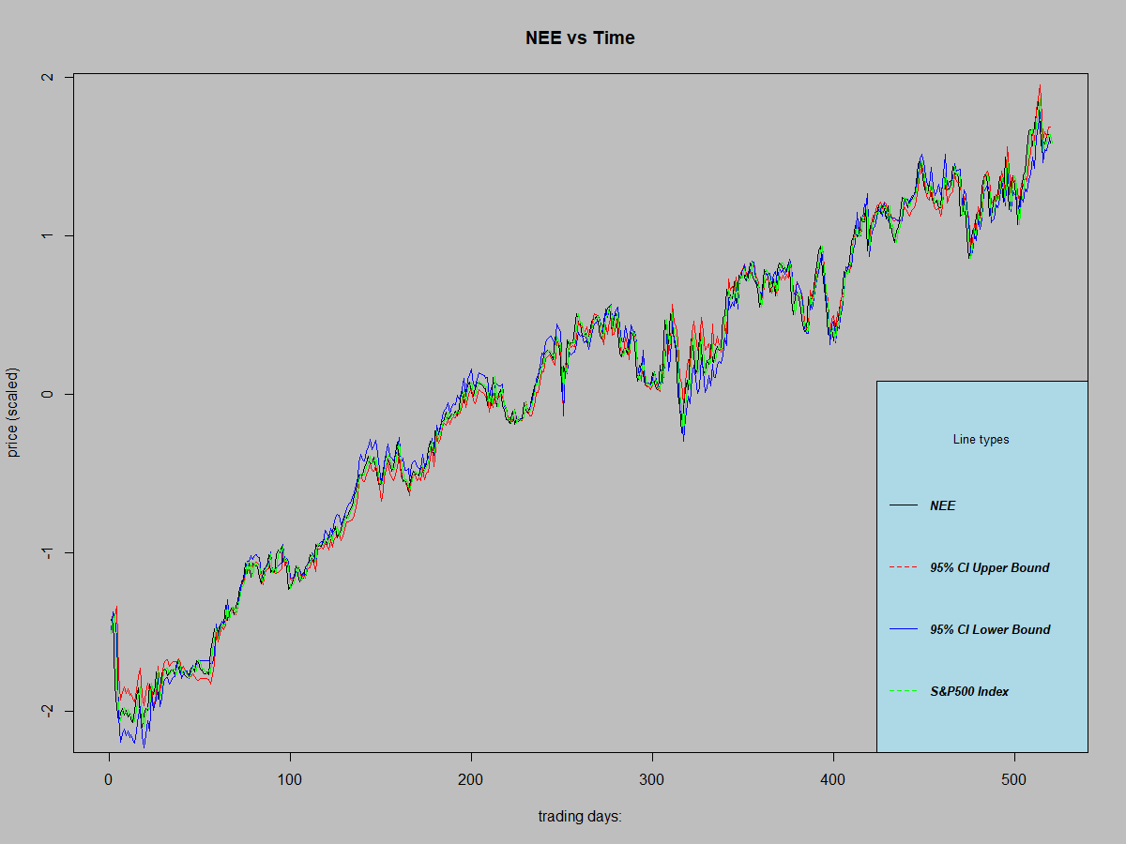

Slide 22
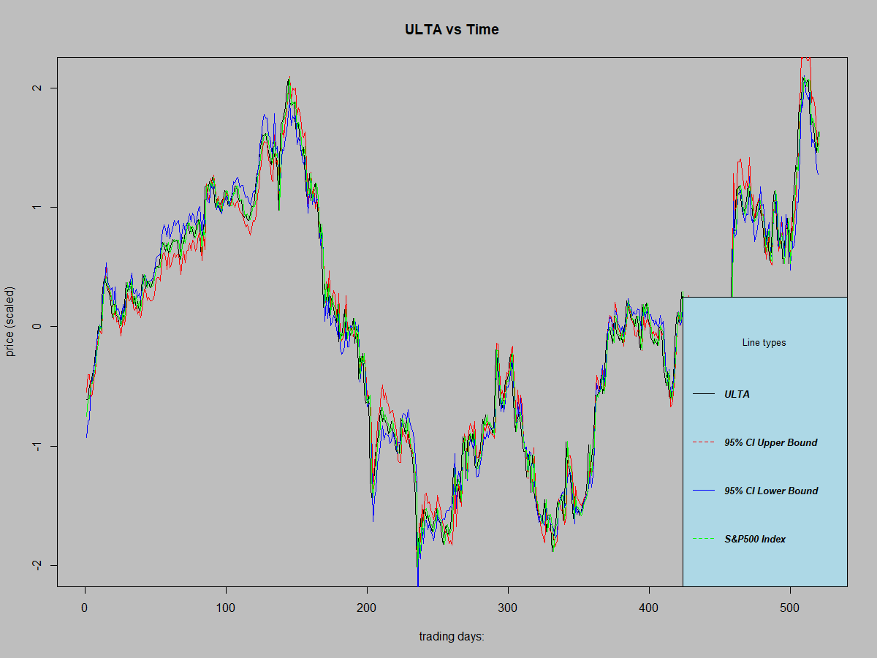

Slide 23
